Slide 1
The Service Operation

Slide 2
Service Operation Principles
1. Balancing Internal IT view versus external business view
2. Stability versus responsiveness
3. Balancing Quality of service versus cost of service
4. Balancing Reactive versus Proactive
5. Communication

Slide 3
Service Operation Processes
There are five processes covered :
Event Management;
Incident Management;
Request Fulfillment;
Problem Management;
Access Management.

Slide 4
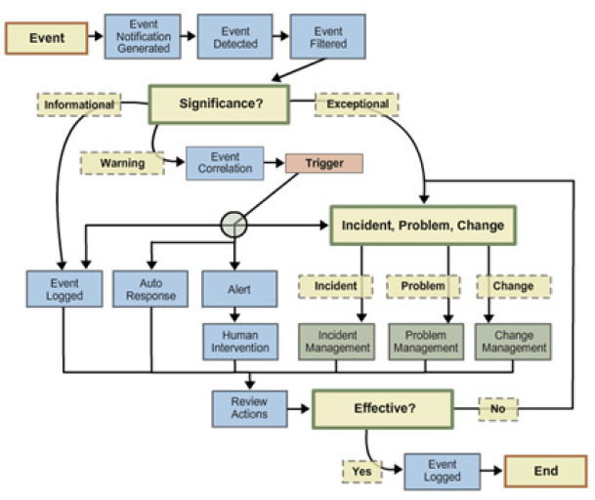
Event Management

Slide 5
Event Management Activities
1. Event Occurs
Events occur continuously, but not all of them are detected or registered. It is therefore important that everybody involved in designing, developing, managing and supporting IT services and the IT Infrastructure that they run on understands what types of event need to be detected.
2. Event Notification
Most CIs are designed to communicate certain information about themselves in one of two ways:
- A device is interrogated by a management tool, which collects certain targeted data. This is often referred to as polling.
- The CI generates a notification when certain conditions are met.
3. Event Detection
Once an Event notification has been generated, it will be detected by an agent running on the same system, or transmitted directly to a management tool specifically designed to read and interpret the meaning of the event.

Slide 6
Event Management Activities
4. Event filtering
The purpose of filtering is to decide whether to communicate the event to a management tool or to ignore it.
- If ignored, the event will usually be recorded in a log file on the device, but no further action will be taken.
- If not ignored, the first level of correlation is performed, i.e. the determination of whether the event is informational, a warning, or an exception (see next step).
This correlation is usually done by an agent that resides on the CI or on a server to which the CI is connected.
The filtering step is not always necessary. For some CIs, every event is significant and moves directly into a management tool’s correlation engine, even if it is duplicated. Also, it may have been possible to turn off all unwanted Event notifications.

Slide 7
Event Management Activities
5. Event categorization
Every organization will have its own categorization of the significance of an event, but it is suggested that at least these three broad categories be represented:
Informational: This refers to an event that does not require any action and does not represent an exception. They are typically stored in the system or service log files and kept for a predetermined period.
Warning: A warning is an event that is generated when a service or device is approaching a threshold. Warnings are intended to notify the appropriate person, process or tool so that the situation can be checked and the appropriate action taken to prevent an exception. Warnings are not typically raised for a device failure. Although there is some debate about whether the failure of a redundant device is a warning or an exception (since the service is still available). A good rule is that every failure should be treated as an exception, since the risk of an incident impacting the business is much greater.
Exception: An exception means that a service or device is currently operating abnormally (however that has been defined). Typically, this means that an OLA and SLA have been breached and the business is being impacted. Exceptions could represent a total failure, impaired functionality or degraded performance. Please note, though, that an exception does not always represent an incident.

Slide 8
Event Management Activities
6. Event Correlation
If an event is significant, a decision has to be made about exactly what the significance is and what actions need to be taken to deal with it. Correlation is normally done by a ‘Correlation Engine’, usually part of a management tool that compares the event with a set of criteria and rules in a prescribed order.
7. Trigger
If the correlation activity recognizes an event, a response will be required. The mechanism used to initiate that response is called a trigger.
8. Response Selection
At this point in the process, there are a number of response options available. It is important to note that the response options can be chosen in any combination. For example, it may be necessary to preserve the log entry for future reference, but at the same time escalate the event to an Operations Management staff member for action.

Slide 9
Event Management Activities
9. Review Actions
With thousands of events being generated every day, it is not possible formally to review every individual event. However, it is important to check
that any significant events or exceptions have been handled appropriately, or to track trends or counts of event types, etc.
In many cases this can be done automatically, for example polling a server that had been rebooted using an automated script to see that it is functioning correctly.
10. Close Event
Some events will remain open until a certain action takes place, for example an event that is linked to an open incident. However, most events are not ‘opened’ or ‘closed’.
Informational events are simply logged and then used as input to other processes, such as Backup and Storage Management. Auto-response events will typically be closed by the generation of a second event. For example, a device generates an event and is rebooted through auto response – as soon as that device is successfully back online, it generates an event that effectively closes the loop and clears the first event.

Slide 10
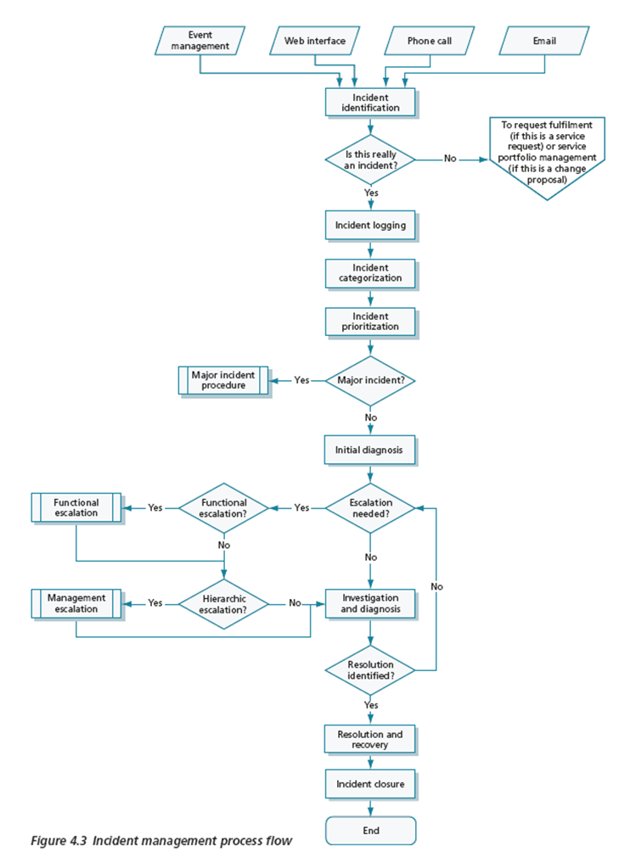
Incident Management
1. Incident identification
2. Incident logging
3. Incident categorization
4. Incident prioritization
5. Initial diagnosis
6. Incident escalation
7. Investigation and Diagnosis
8. Resolution and Recovery
9. Incident Closure

Slide 11
Incident: Key Performance Indicators
The metrics that should be monitored and reported upon to judge the efficiency and effectiveness of the Incident Management process, and its operation. Examples:
- Total numbers of Incidents (as a control measure)
- Breakdown of incidents at each stage (for example logged: WIP, or closed)
- Size of current incident backlog
- Number and percentage of major incidents
- Mean elapsed time to achieve Incident resolution
- Percentage of incidents handled within agreed response time
- Average cost per Incident
- Number of incidents reopened and as a percentage of the total
- Number and percentage of incidents incorrectly assigned
- Number and percentage of incidents incorrectly categorized

Slide 12
Request Fulfillment
Scope
The process needed to fulfill a request will vary depending upon exactly what is being requested – but can usually be broken down into a set of activities that have to be performed. Some organizations will be comfortable to let the Service Requests be handled through their Incident Management processes (and tools) – with Service Requests being handled as a particular type of ‘incident’ (using a high-level categorization system to identify those ‘incidents’ that are in fact Service Requests).

Slide 13
Request Fulfillment: Process Activities
Menu Selection: Request Fulfillment offers great opportunities for self-help practices where users can generate a Service Request using technology that links into Service Management tools.
Financial Approval: Most requests will have some form of financial implications, regardless of the type of commercial arrangements in place. The cost of fulfilling the request must first be established.
Other Approvals: In some cases further approval may be needed – such as compliance-related or wider business approval.
Fulfillment: The actual fulfillment activity will depend upon the nature of the Service Request. Some simpler requests may be completed by the Service Desk, acting as first-line support, while others will have to be forwarded to specialist groups and/or suppliers for fulfillment.
Closure: When the Service Request has been fulfilled it must be referred back to the Service Desk for closure.

Slide 14
Problem Management
Goal
Prevent problems and resulting incidents from happening;
Eliminate recurring incidentes;
- Minimize the impact of incidents that cannot be prevented.

Slide 15
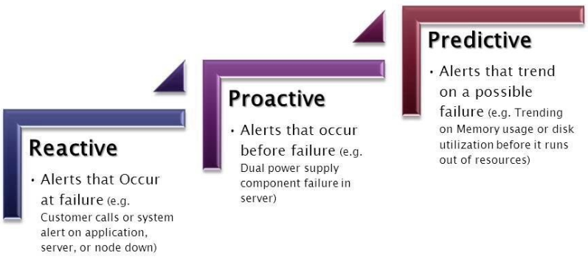
Reactive vs Proactive vs Predictive

Slide 16
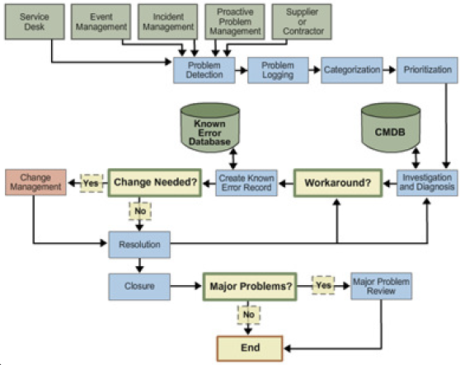
Problem Management: Activities

Slide 17
Access Management
It comprises the following basic concepts:
Access refers to the level and extent of a service’s functionality or data that a user is entitled to use.
Identity refers to the information about them that distinguishes them as an individual and which verifies their status within the organization. By definition, the Identity of a user is unique to that user.
Rights (also called privileges) refer to the actual settings whereby a user is provided access to a service or group of services. Typical rights, or levels of access, include read, write, execute, change, delete.
Services or service groups. Most users do not use only one service, and users performing a similar set of activities will use a similar set of services. Instead of providing access to each service for each user separately, it is more efficient to be able to grant each user – or group of users – access to the whole set of services that they are entitled to use at the same time.
Directory Services refers to a specific type of tool that is used to manage access and rights.

Slide 18
Access Management – Process Activities
Requesting Access;
Verification;
Providing Rights;
Monitoring Identity Status;
Logging and Tracking Access;
Removing and Restricting Rights;

Slide 19
References
https://www.globalknowledge.com/blog/2012/04/18/incident-management-process-flow-which-comes-first-categorization-or-initial-diagnosis/

